Slide 1
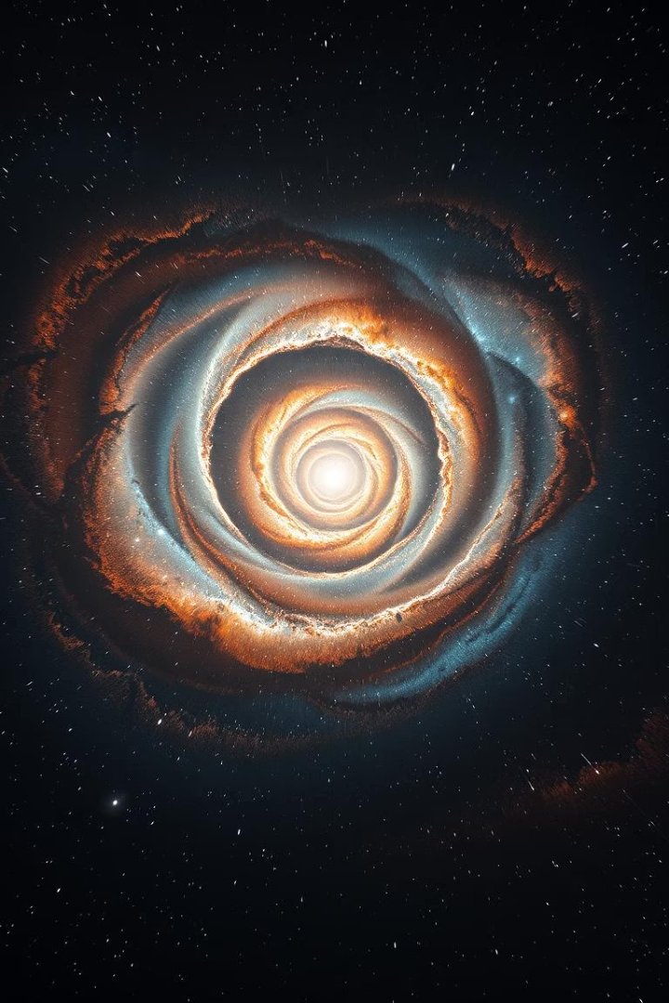
Stellar Classification using Machine Learning
Arnav Sharma —DL.AI.U4AID24146
Hemant —DL.AI.U4AID24039
Neeraj —DL.AI.U4AID24045
Sriyansh —DL.AI.U4AID24040
Faculty Guide: Prof. Sri Geetha M
Course: 23AID205 – Introduction to AI & ML

Slide 2
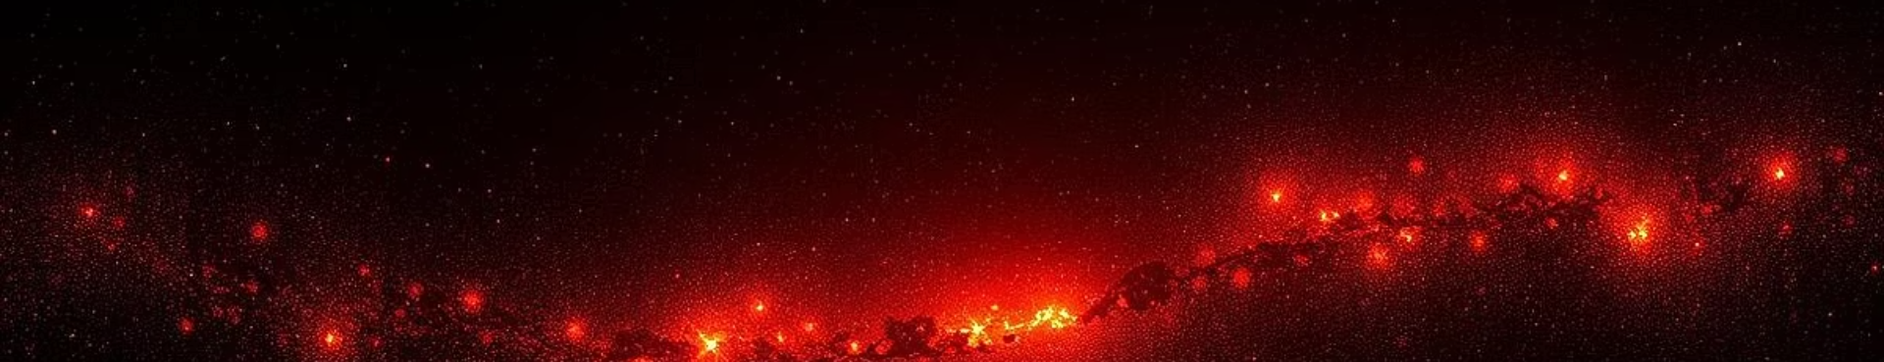
Introduction:
This project applies machine learning techniques to classify astronomical objects—Stars, Galaxies, and quasar or QSOs (Quasi-Stellar Objects)—using data from the SDSS (Sloan Digital Sky Survey). We calculate color indices (like u-g, g-r, r-i, and i-z) from photometric bands to capture spectral differences.
Two approaches are used:
Unsupervised Learning (KMeans) to explore natural groupings in the data.
Supervised Learning (SVM) to train a classifier that accurately predicts object types based on labeled data.
This enables the automation of celestial classification, which is essential for handling large-scale astronomical datasets.

Slide 3
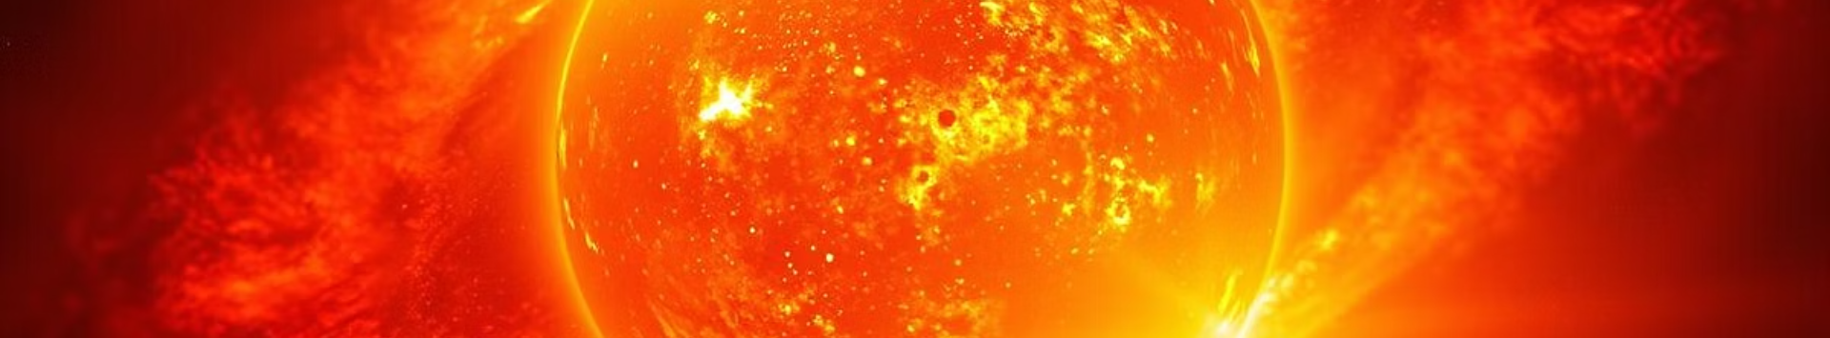
Project Goal
Goal 1: Data Preparation & EDA
Goal 2: Star Classification Model Development
Goal 3: Model Evaluation & Optimization Evaluate the classification model's performance and optimize it for better accuracy and generalization.
Clean and analyze the star_classification.csv.xlsx dataset, focusing on missing values and understanding spectral feature distributions.
Build and train a machine learning model to classify celestial objects (GALAXY, STAR, QSO) using spectral data.

Slide 4
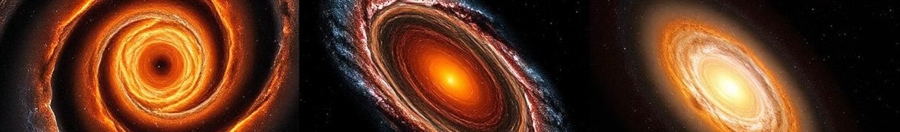
Dataset and Features
Data Source
Sloan Digital Sky Survey (SDSS)
Features
u, g, r, i, z
Numerical
Magnitude in SDSS photometric bands
u_g, g_r, r_i, i_z
Numerical
Color indices (e.g., u - g, g - r)
Target Variable
class (Star, Galaxy, Quasar)
Size
The dataset contains 100,000 rows, rows and 18 columns
Missing values
No missing values but has 1 row with values -9999(due to sensor error).

Slide 5
Machine Learning Models used
Linear Regression
K means Clustering
We are identifying highly correlated pairs of features from our cleaned dataset. For each such pair, we fit a linear regression model to understand their relationship, calculate the R^2 score to assess the fit, and visualize it with a regression line.
In our project, K-Means clustering is used as an unsupervised learning technique. It helps us explore and identify natural groupings or patterns within the star classification data based on spectral characteristics, without relying on the known class labels
SVM (Support Vector Machine)(using RBF kernel)
SVM is employed as a supervised learning model in our project. Its purpose is to build a robust classifier that learns to accurately differentiate and predict the class (GALAXY, STAR, or QSO) of a celestial object by finding the optimal decision boundary between these categories using their spectral features. After training, we evaluate its accuracy on both the training and a separate test set to assess its performance.

Slide 6
Data Preprocessing
Dataset Loading: The star_classification.csv.xlsx dataset was loaded using pandas.
The print(df.isnull().sum()) command is used to check for the presence and count of missing (NaN) values in each column of the DataFram
Missing Values Handling: Placeholder values (-9999.0) in spectral features (u, g, z) were replaced with NaN, and rows containing these NaNs were then dropped.
Target Variable: The class column was identified as the categorical target for classification tasks.
The msno.matrix(df) command generates a missingness matrix plot for the DataFrame df. This visualization provides a concise and clear representation of the presence and patterns of missing data across all columns.

Slide 7
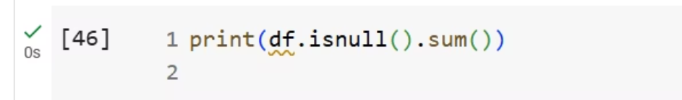
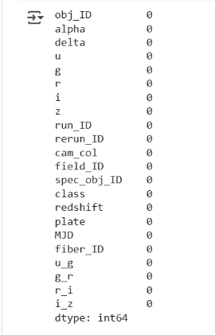
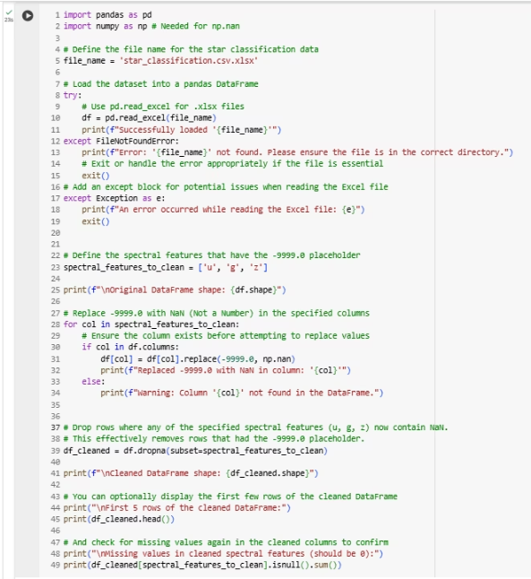
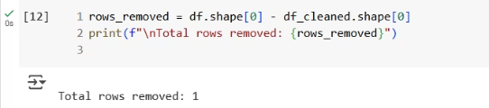
(i) Code for Data Preprocessing

Slide 8
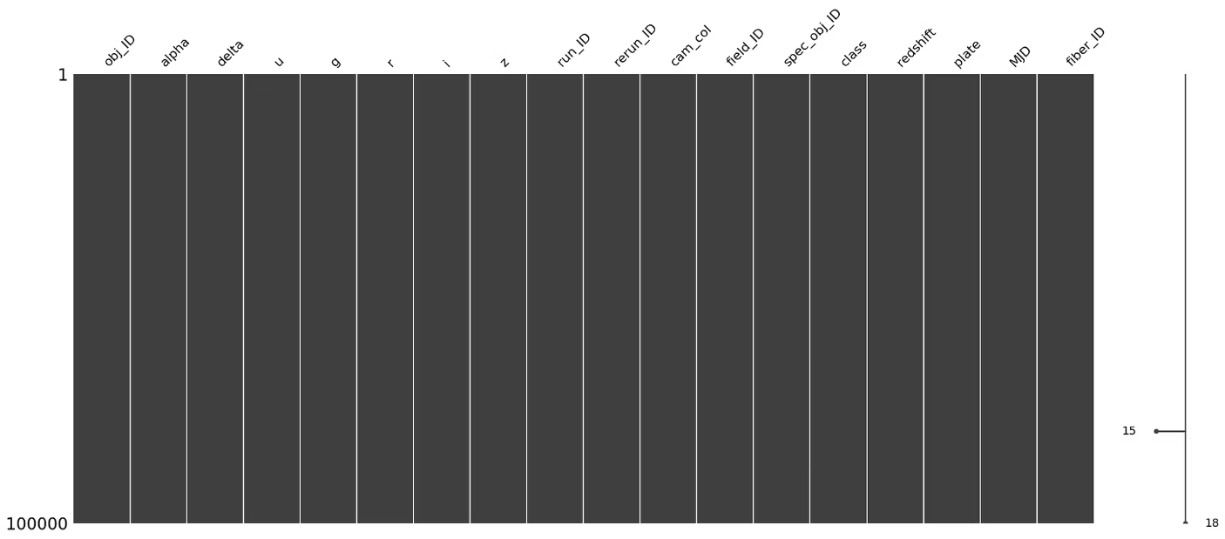
Missingness Matrix Plot

Slide 9
Exploratory Data Analysis:
print(df.shape), print(df.info()), and print(df.head()) are commands used for Exploratory Data Analysis (EDA). They provide essential initial insights into the dataset's structure, column data types, presence of non-null entries, and a quick preview of the raw data. While not directly modifying the data, these steps are fundamental for understanding the dataset and guiding subsequent data preprocessing decisions.
The print(df.describe()) command generates descriptive statistics for the numerical columns in your DataFrame. This includes key statistical measures such as:
Count: The number of non-null entries.
Mean: The average value.
Std (Standard Deviation): A measure of the dispersion of values.
Min/Max: The minimum and maximum values.
25th, 50th (Median), 75th Percentiles: Quartile values that show the distribution of the data.
3. The print(df['class'].value_counts()) command is used to display the frequency of each unique value within the 'class' column. This provides a count of how many times each celestial object type (GALAXY, STAR, QSO) appears in our dataset.

Slide 10
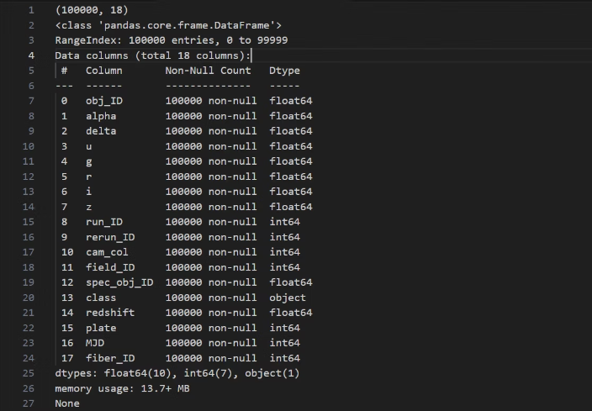
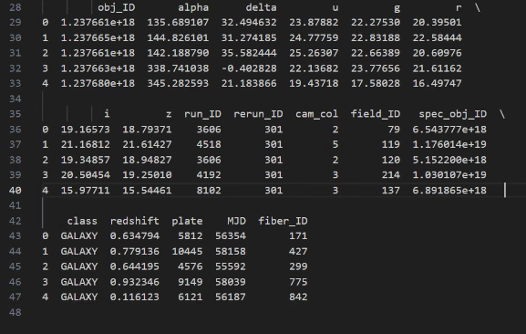
ii) Output of 1'st EDA

Slide 11
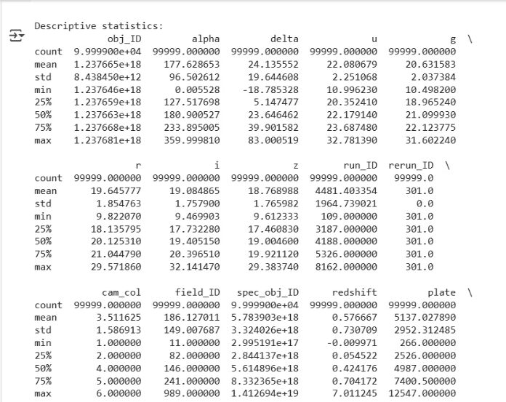
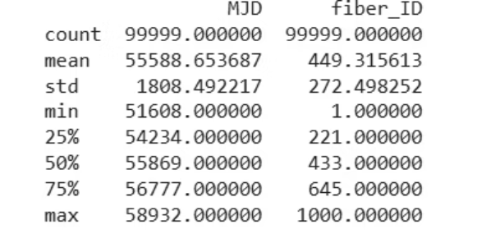
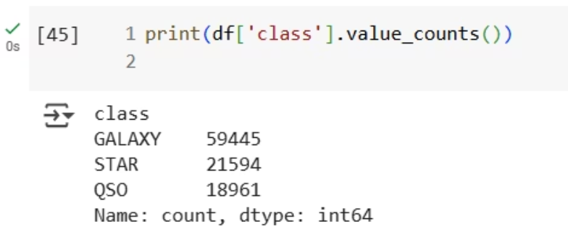
iii) Output of 2nd EDA
iv) Output of 3rd EDA

Slide 12
Histograms of Spectral Features
We generates histograms for each of the specified spectral features (u, g, r, i, z) from the df DataFrame. Each histogram visualizes the distribution of values for a single feature.
This is a key step in Exploratory Data Analysis (EDA), as it helps us to:
Understand Value Distribution: See how the values for each spectral feature are spread out, identifying common ranges, peaks, and sparsity.
Identify Skewness: Observe if the data is skewed to one side (e.g., right-skewed or left-skewed), which might necessitate transformations for some models.
Detect Outliers: Notice any extreme values that fall far from the main body of the data, potentially indicating outliers.
Assess Data Quality: Get a visual sense of the overall quality and characteristics of the spectral measurements, which is crucial before applying machine learning models for star classification.

Slide 13
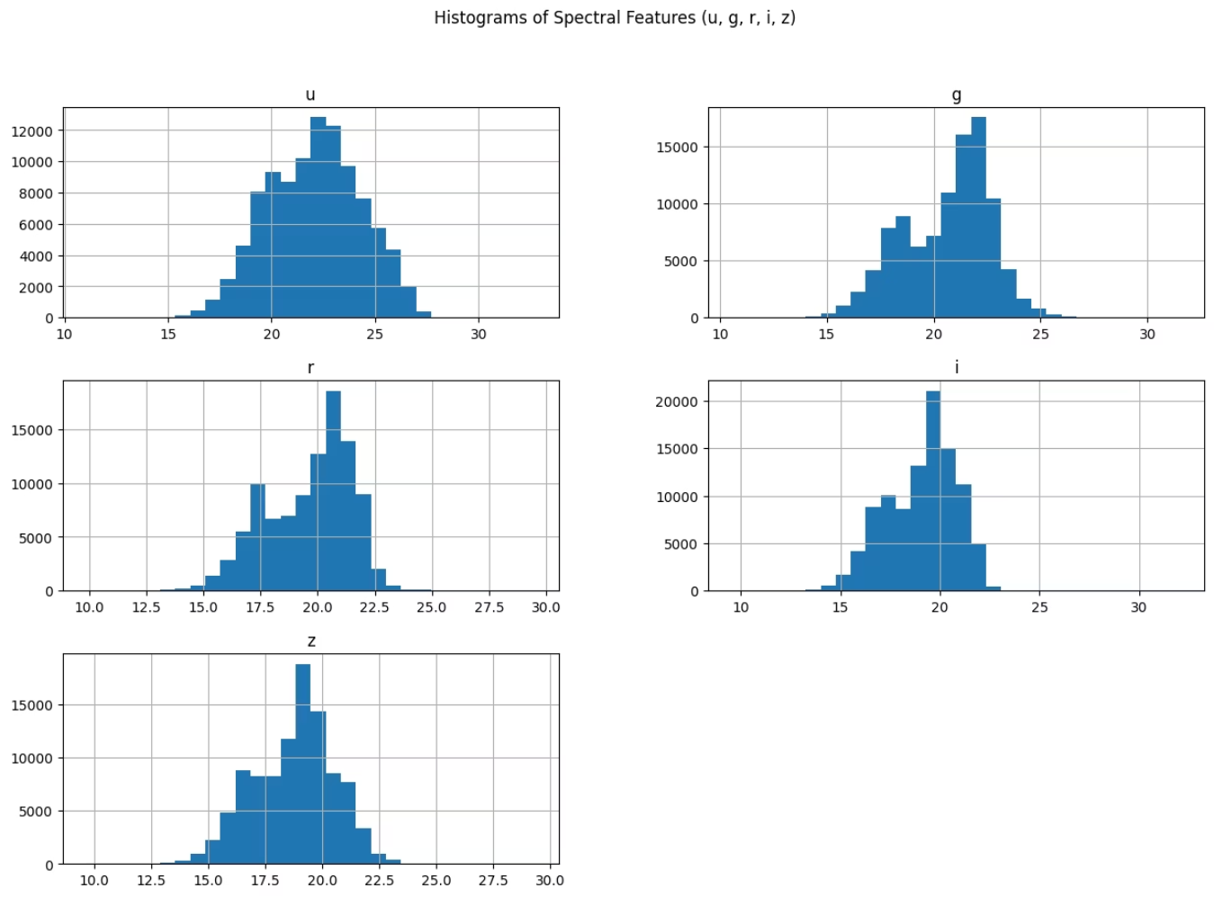
Figure 1: Histogram of Spectral Features

Slide 14
Pairplot of Spectral Features by Class
The provided code uses sns.pairplot() to generate a pairplot for the selected spectral_features (u, g, r, i, z), with data points colored according to their class (GALAXY, STAR, QSO).
This comprehensive visualization tool is invaluable for Exploratory Data Analysis (EDA) because it simultaneously displays:
Univariate Distributions: Histograms (or KDE(Kernel Density Estimation.) plots() on the diagonal show the distribution of each individual spectral feature for each class.
Bivariate Relationships: Scatter plots for every possible pair of spectral features, allowing us to visually inspect correlations, clusters, and patterns between features.
Class Separability: By coloring points by class, it clearly illustrates how well the different types of celestial objects are separated or overlap based on their spectral characteristics. This is crucial for assessing the potential effectiveness of classification models.

Slide 15
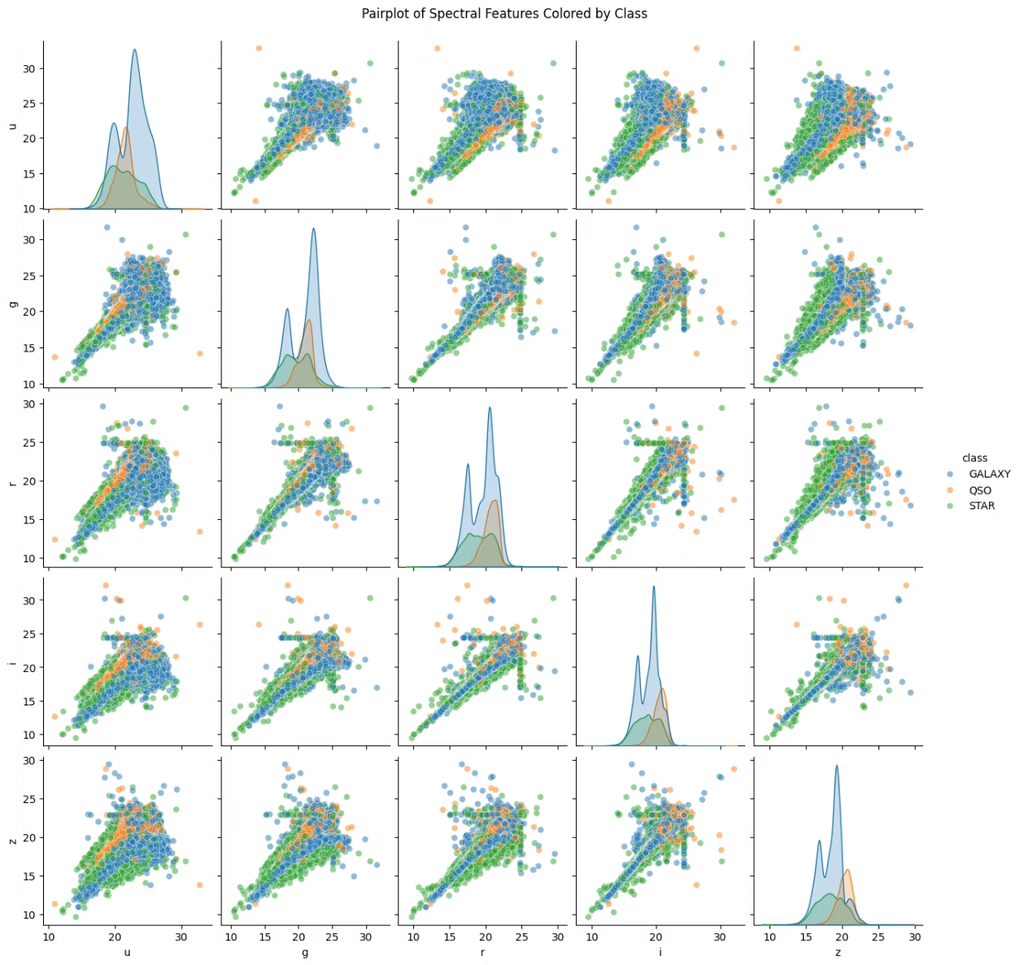
Figure 2: Pairplot of Spectral Features

Slide 16
Correlation Matrix and Heatmap of Spectral Features
The provided code calculates the correlation matrix for the spectral features (u, g, r, i, z) using df.corr(). This matrix quantifies the linear relationship between every pair of these numerical features.
Then, sns.heatmap() visualizes this correlation matrix as a heatmap. This graphical representation uses color intensity to depict the strength and direction (positive or negative) of the correlations, with annot=True displaying the exact correlation values.
This is a critical step in Exploratory Data Analysis (EDA), as it helps us to:
Understand Feature Relationships: Quickly identify which spectral features are highly correlated with each other.
Detect Multicollinearity: High correlation between independent features can indicate multicollinearity, which might affect the performance or interpretability of certain machine learning models.
Inform Feature Selection: Insights from the correlation matrix can guide decisions on feature engineering or feature selection, such as potentially removing highly redundant features.

Slide 17
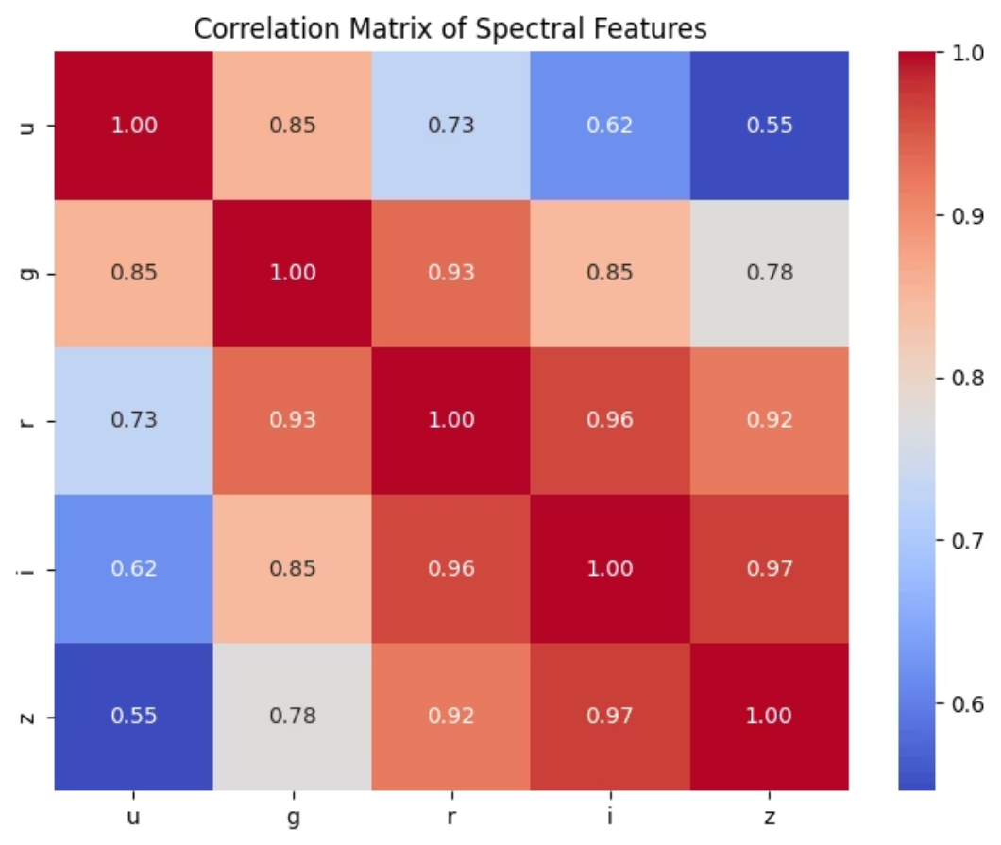
Figure 3: Correlation Matrix of Spectral Features

Slide 18
Boxplot of Spectral Features
The provided code uses sns.boxplot() to generate boxplots for each of the specified spectral features (u, g, r, i, z). A boxplot is a standardized way of displaying the distribution of data based on a five-number summary: minimum, first quartile (Q1​), median (Q2​), third quartile (Q3​), and maximum.
This visualization is highly valuable in Exploratory Data Analysis (EDA) for:
Understanding Data Spread and Central Tendency: Quickly grasping the median value, the interquartile range (IQR, which is Q3​−Q1​), and the overall spread of the data for each feature.
Identifying Outliers: Individual points plotted beyond the "whiskers" of the boxplot represent potential outliers, which are values significantly different from the majority of the data.
Comparing Distributions: Easily comparing the distributions of different spectral features side-by-side, noting differences in their median, spread, and presence of outliers.

Slide 19
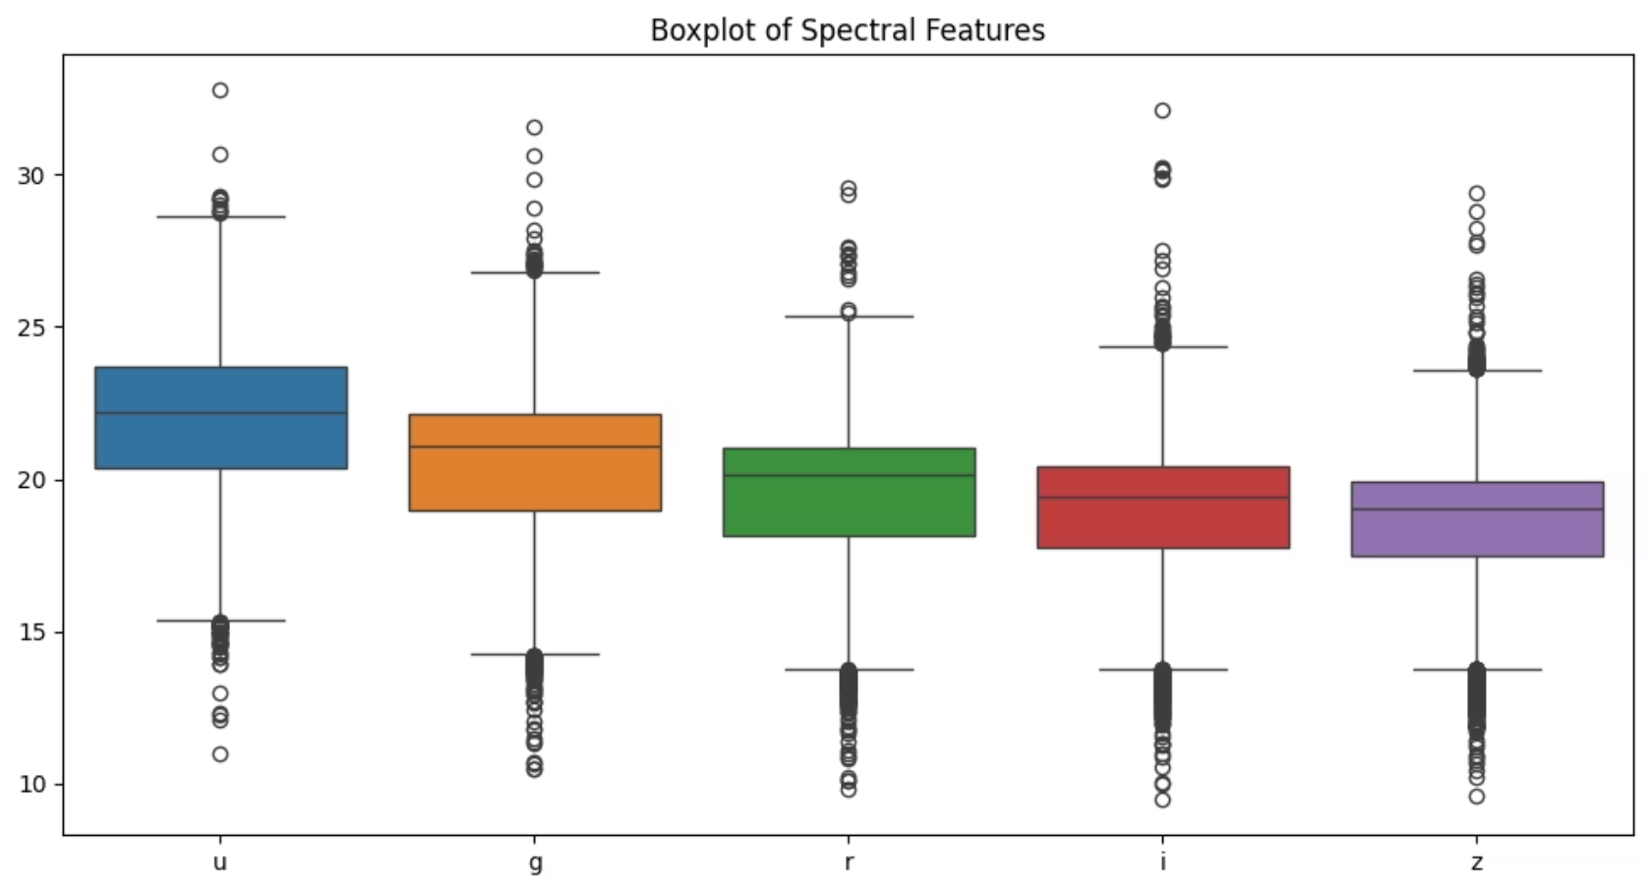
Figure 4: Boxplot of Spectral Features

Slide 20
Boxplots of Spectral Features by Class
The provided code generates individual boxplots for each spectral feature (u, g, r, i, z), but crucially, it visualizes the distribution of each feature segmented by the celestial class (GALAXY, STAR, QSO).
This type of visualization is exceptionally valuable in Exploratory Data Analysis (EDA) for classification tasks as it allows us to:
Assess Class Separability: Directly observe how the distribution of each spectral feature varies across the different celestial object classes. Features with distinct boxplot ranges and medians for different classes are likely good discriminators.
Understand Class-Specific Characteristics: Gain insights into the typical range, spread, and median values of a spectral band for each type of object (e.g., how the 'u' band might differ significantly between a Star and a Galaxy).
Identify Outliers within Classes: Detect unusual spectral readings for specific object types, which might represent rare phenomena or data anomalies.

Slide 21
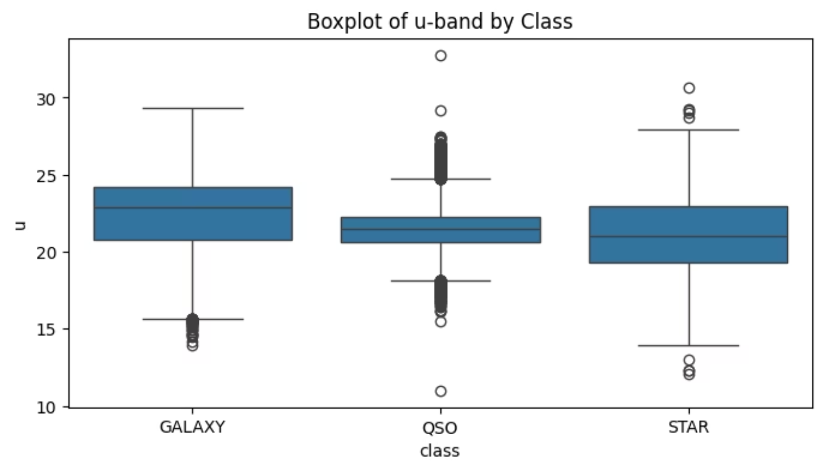
Figure 5: Boxplot of u-band by Class

Slide 22
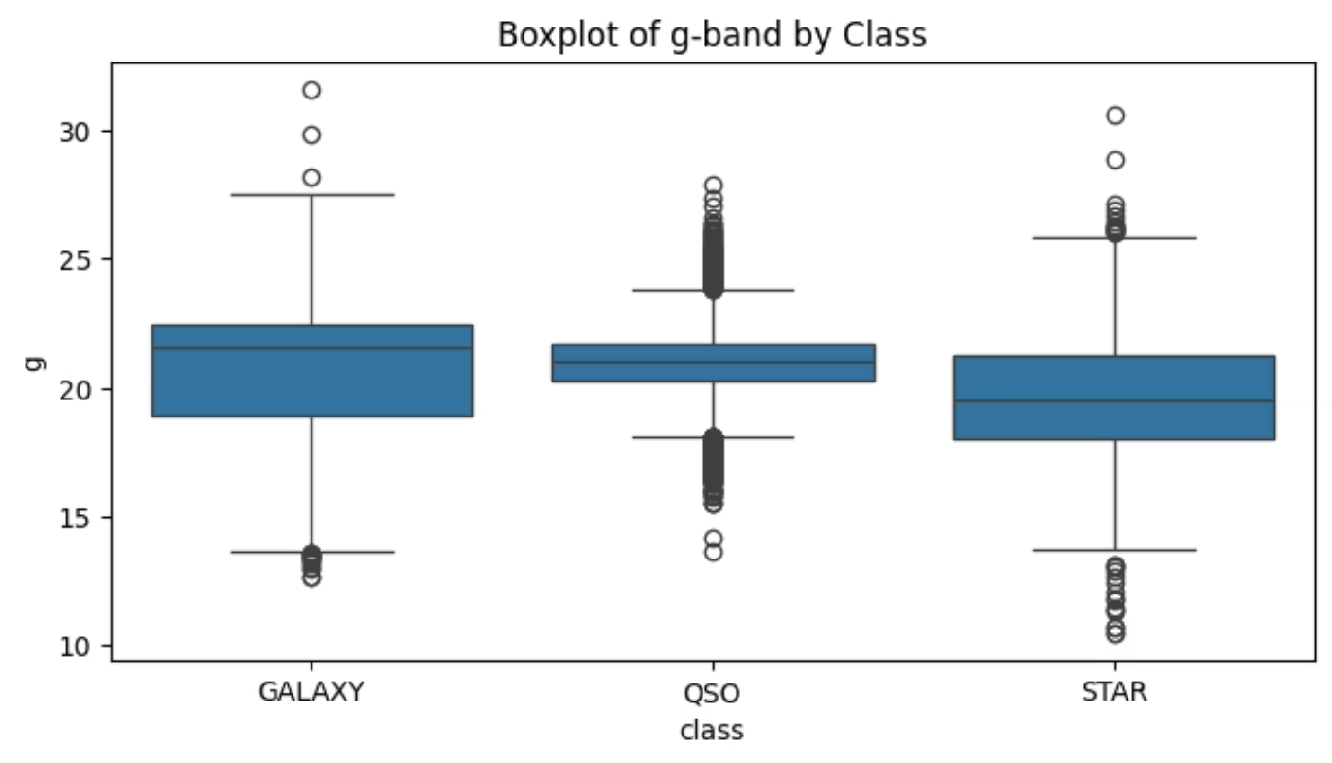
Figure 6: Boxplot of g-band by Class

Slide 23
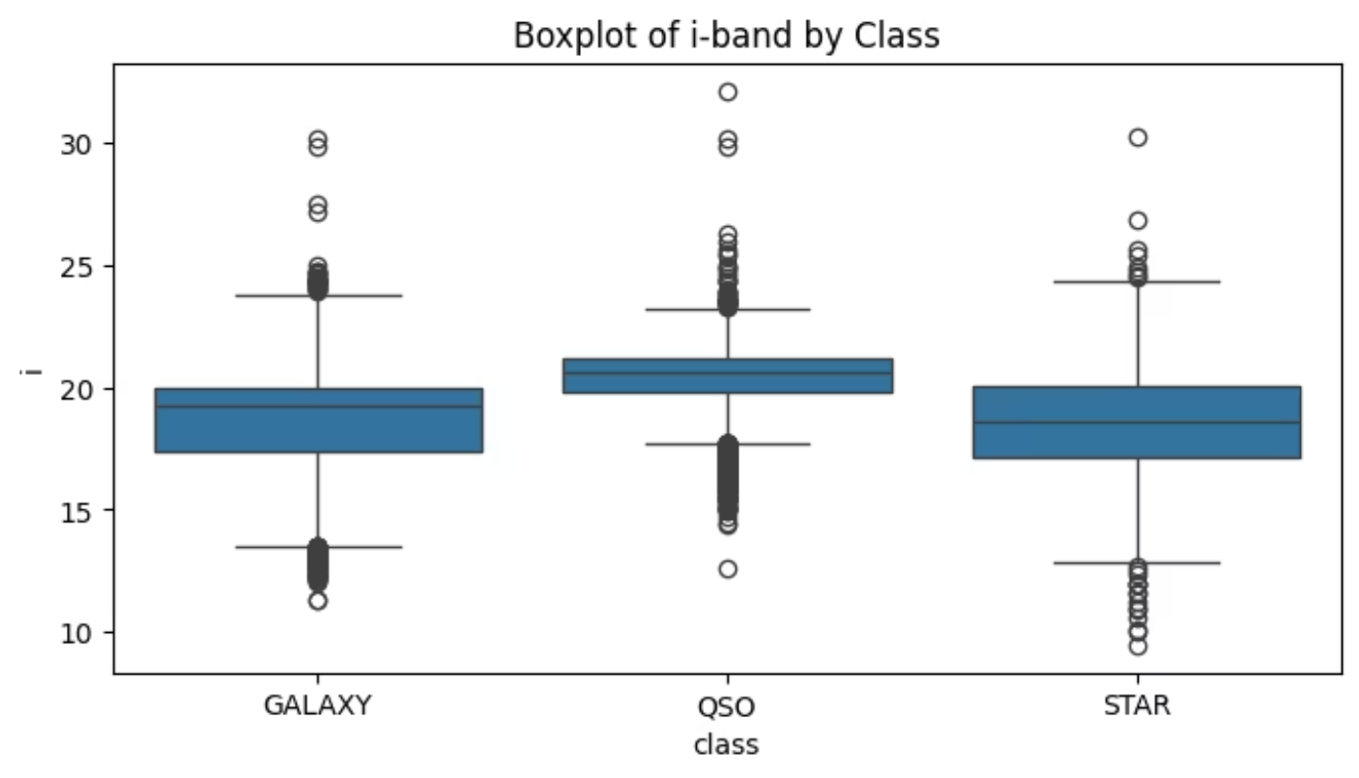
Figure 7: Boxplot of i-band by Class

Slide 24
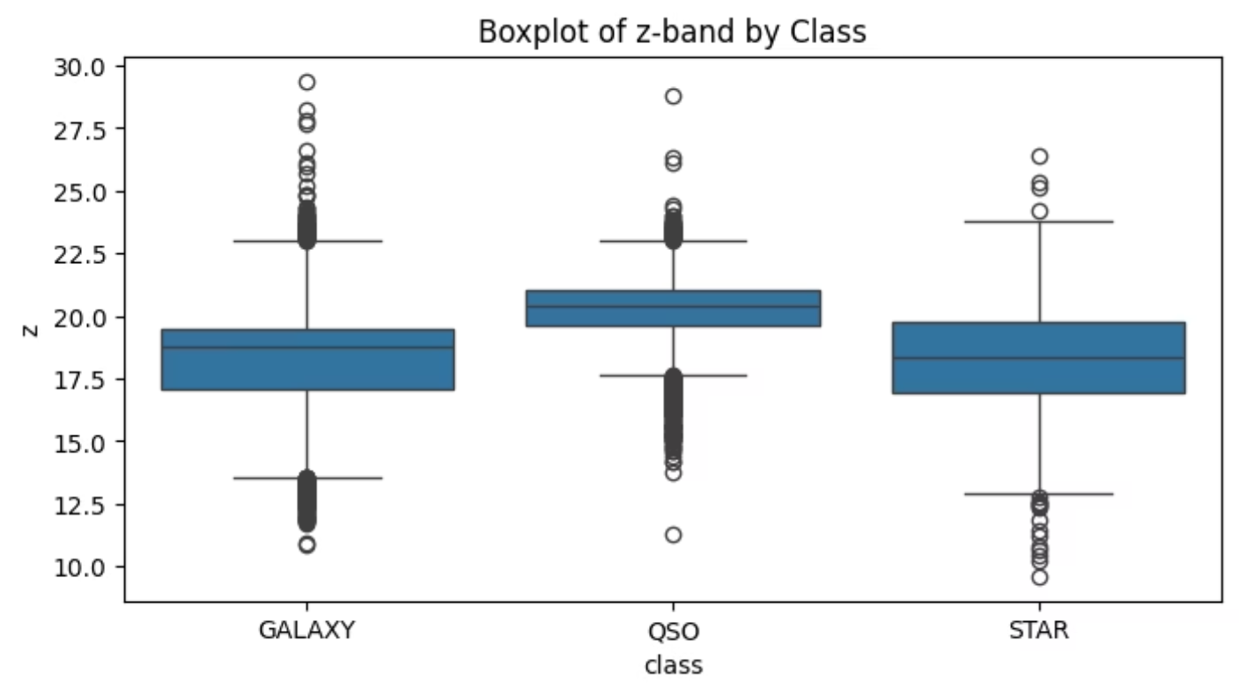
Figure 8: Boxplot of z-band by Class

Slide 25
Kernel Density Estimation (KDE) Plots of Spectral Features by Class
The provided code iterates through each of the specified spectral_features (u, g, r, i, z) and generates a Kernel Density Estimate (KDE) plot for each feature, with separate density curves displayed for each celestial class (GALAXY, STAR, QSO).
A KDE plot visualizes the probability density function of a continuous variable, providing a smoothed representation of the data's distribution.
hue='class' is crucial here as it creates separate density curves for each category within the 'class' column.
common_norm=False ensures that each class's density curve is normalized independently, allowing for a clearer comparison of their shapes regardless of the number of samples in each class.
This visualization is highly valuable in Exploratory Data Analysis (EDA) for classification tasks because it allows us to:
Visualize Feature Distributions by Class: Clearly see the shape, spread, and peak(s) of the distribution of each spectral feature for each specific class.
Assess Class Overlap and Separation: Directly observe the degree of overlap or distinct separation between the density curves of different classes for a given feature. Features with minimal overlap are strong discriminators.
Identify Class-Specific Trends: Understand unique patterns or concentrations of spectral values for galaxies, stars, and quasars, which might not be as apparent in histograms.

Slide 26
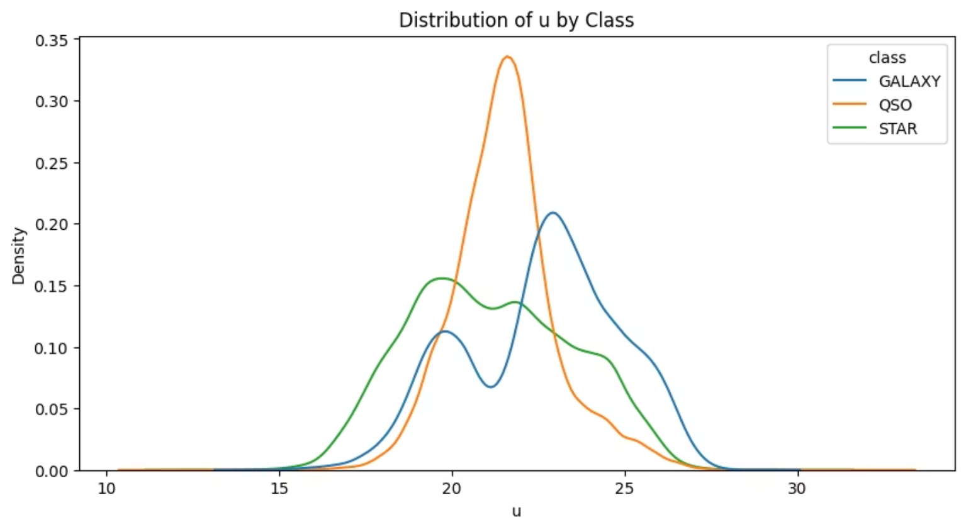
Figure 9: KDE plot of u by Class

Slide 27
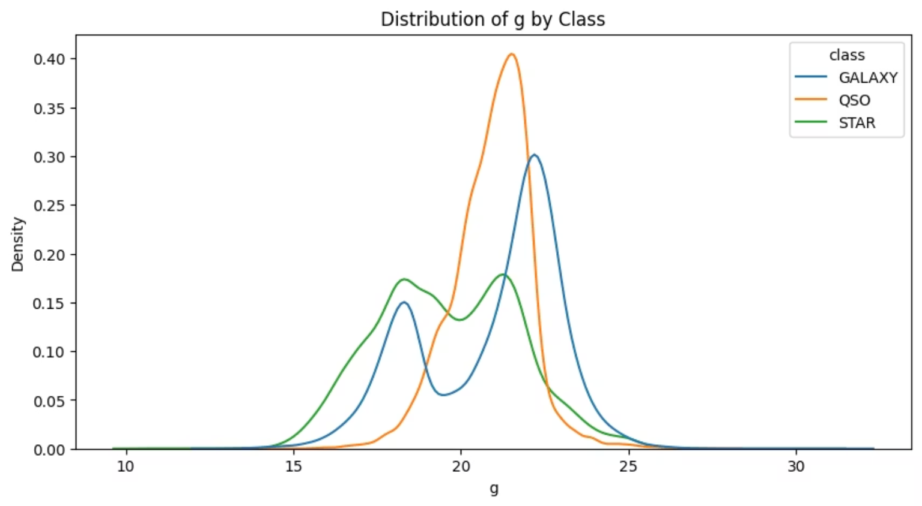
Figure 10: KDE plot of g by Class

Slide 28
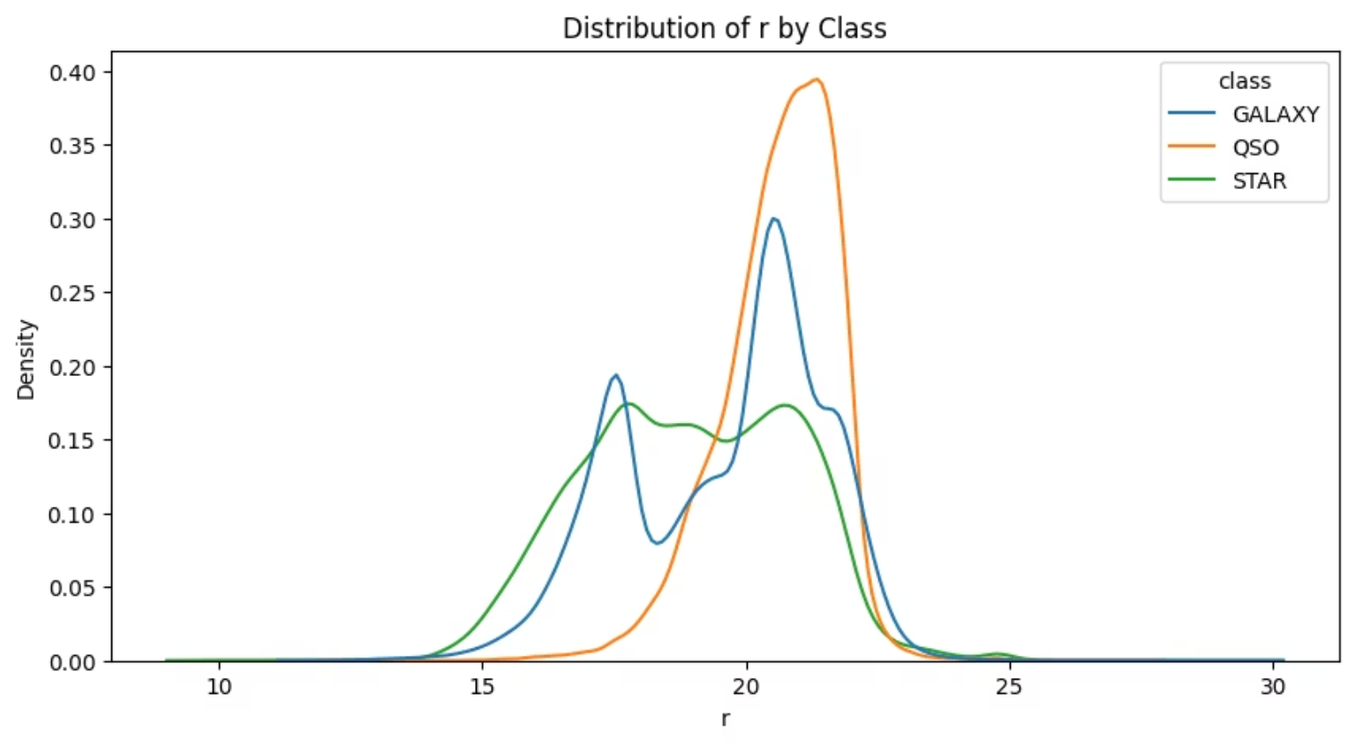
Figure 11: KDE plot of r by Class

Slide 29
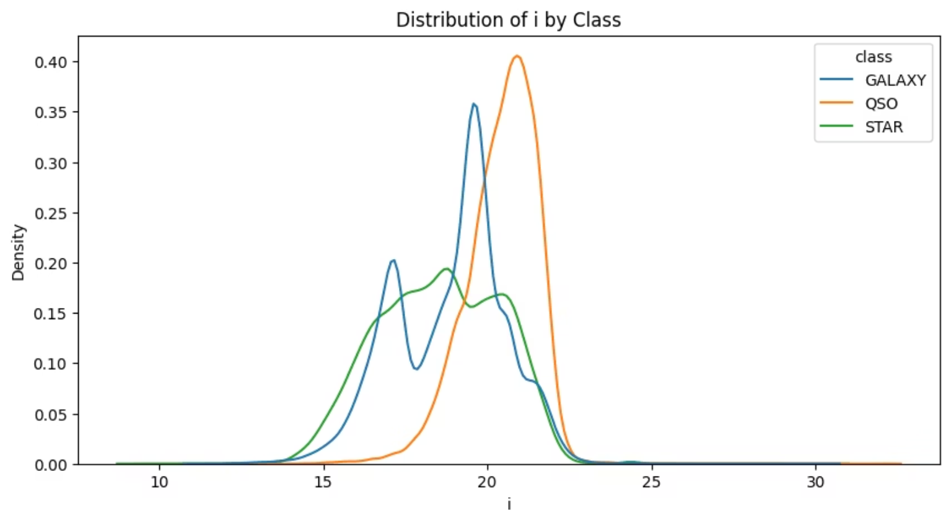
Figure 12: KDE plot of i by Class

Slide 30
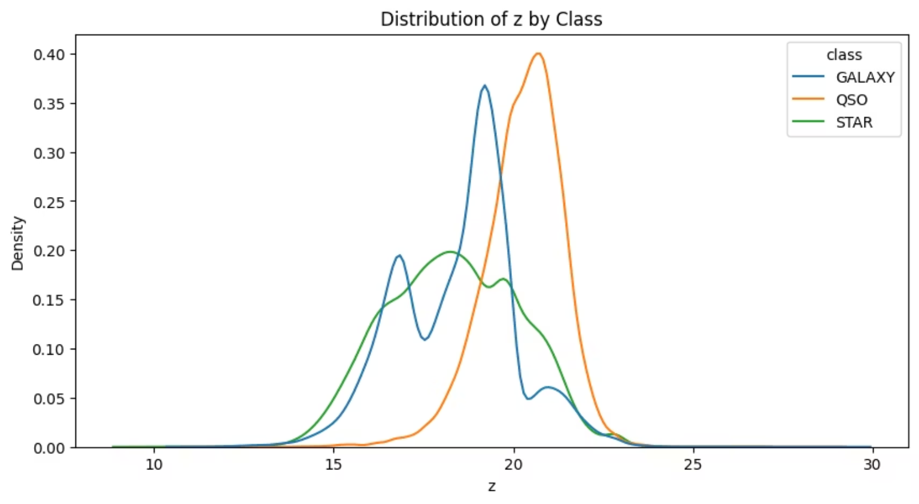
Figure 13: KDE plot of z by Class

Slide 31
Linear Regression for Highly Correlated Attributes
The provided code identifies pairs of spectral features that exhibit a high degree of linear correlation (above a threshold of 0.85). For each identified pair, it then performs a linear regression analysis.
This involves:
Fitting a LinearRegression model using one feature as the independent variable (X) and the other as the dependent variable (y).
Calculating the regression equation (slope and intercept) which describes the linear relationship.
Determining the R² score, a statistical measure indicating how well the regression line fits the observed data points (i.e., the proportion of the variance in the dependent variable that is predictable from the independent variable).
Visualizing this relationship through a scatter plot that includes the actual data points and the fitted regression line.
This analysis is valuable in our project's Exploratory Data Analysis (EDA) phase for:
Understanding Feature Dependencies: Gaining insight into strong linear relationships between different spectral measurements.
Identifying Multicollinearity: High correlations suggest multicollinearity, where one feature can be linearly predicted from another. This can be important for certain machine learning models and might influence feature selection strategies.
Data Validation: Confirming expected physical relationships between spectral bands

Slide 32
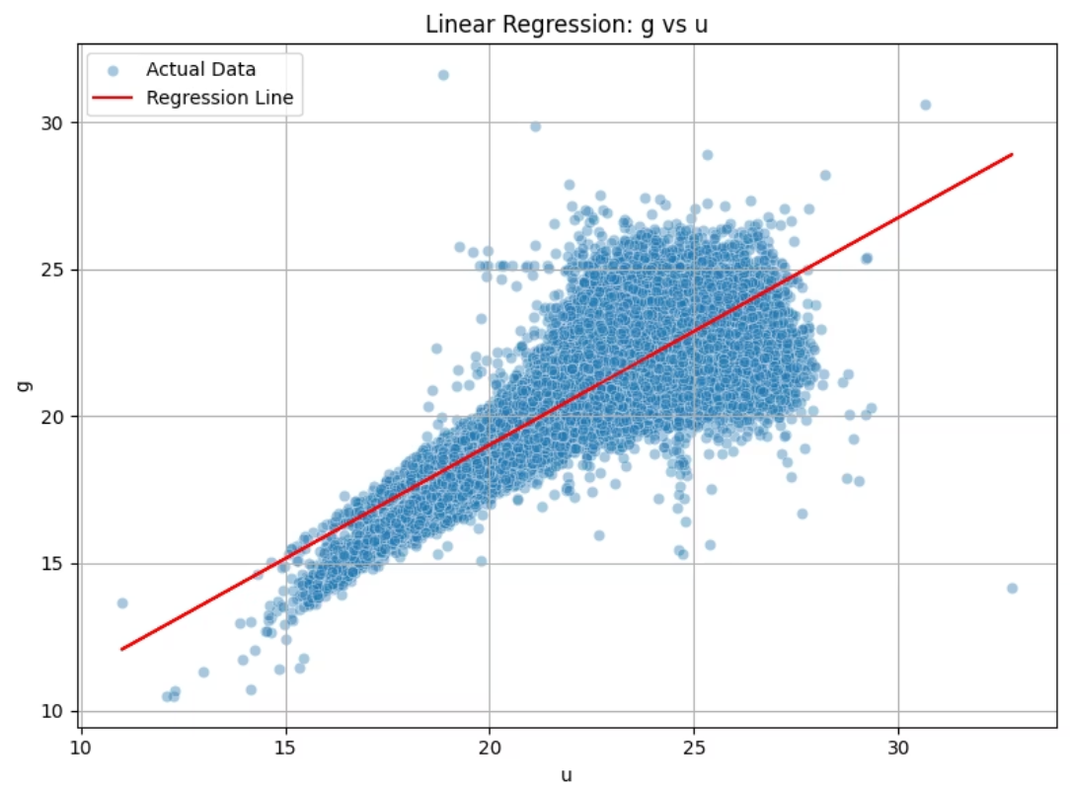
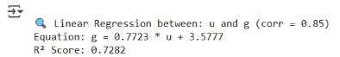
Figure 14: Linear Regression g vs u

Slide 33
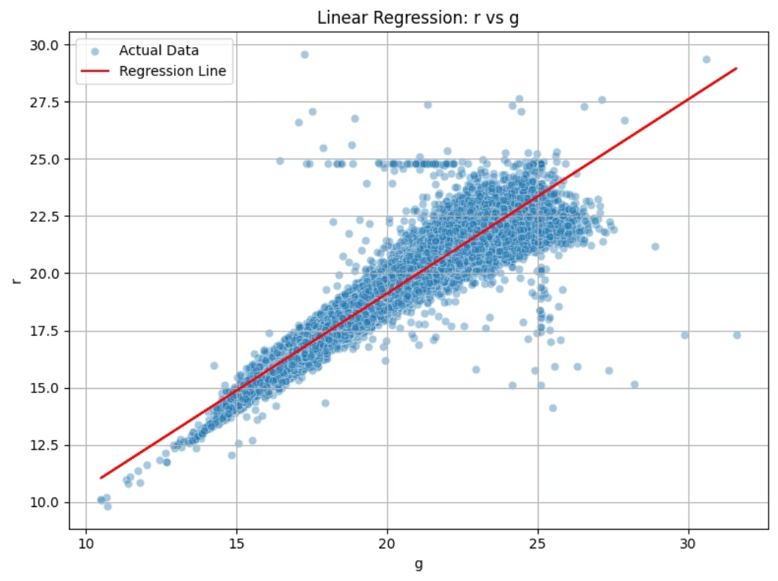
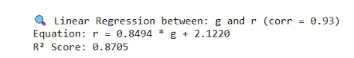
Figure 15: Linear Regression r vs g

Slide 34
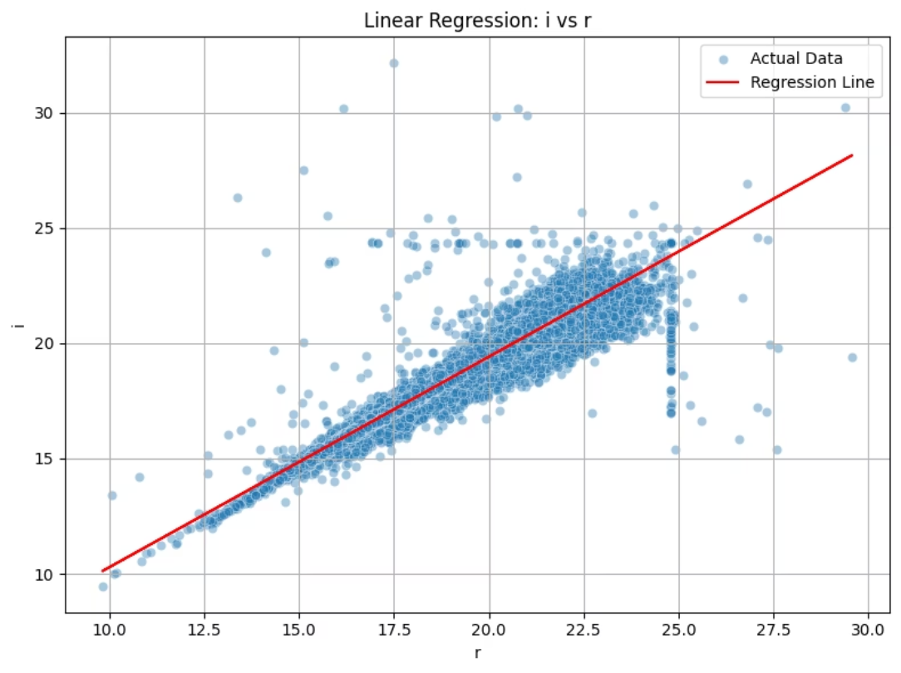
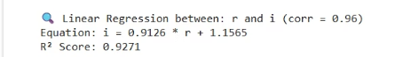
Figure 16: Linear Regression r vs I

Slide 35
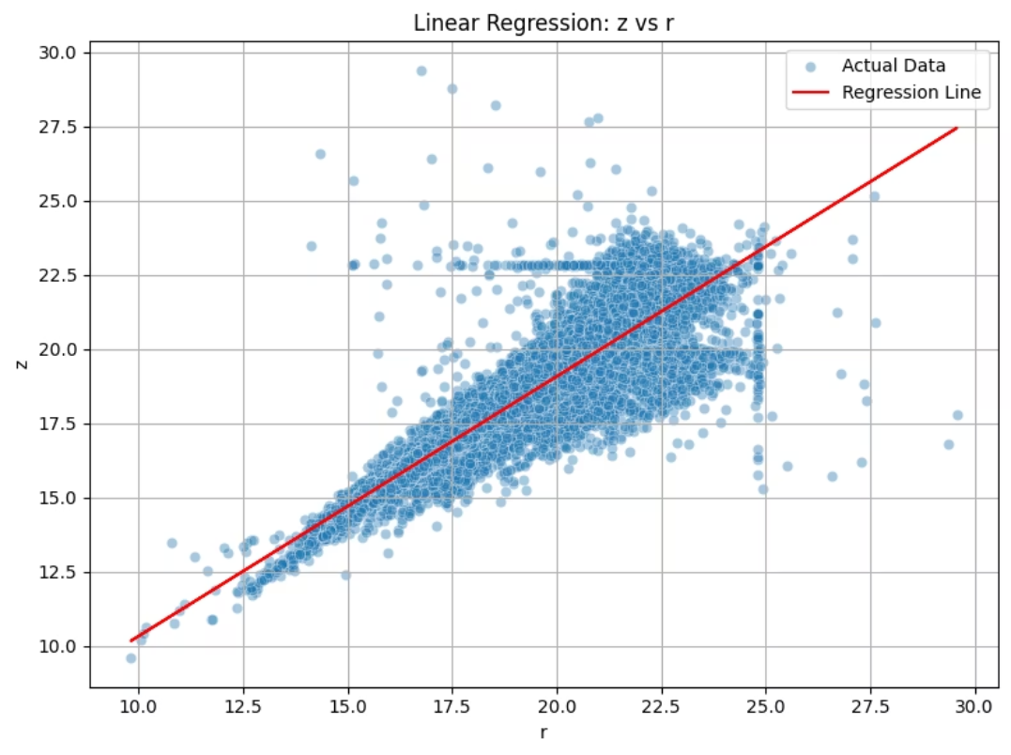
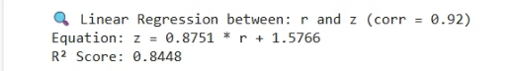
Figure 17: Linear Regression z vs r

Slide 36
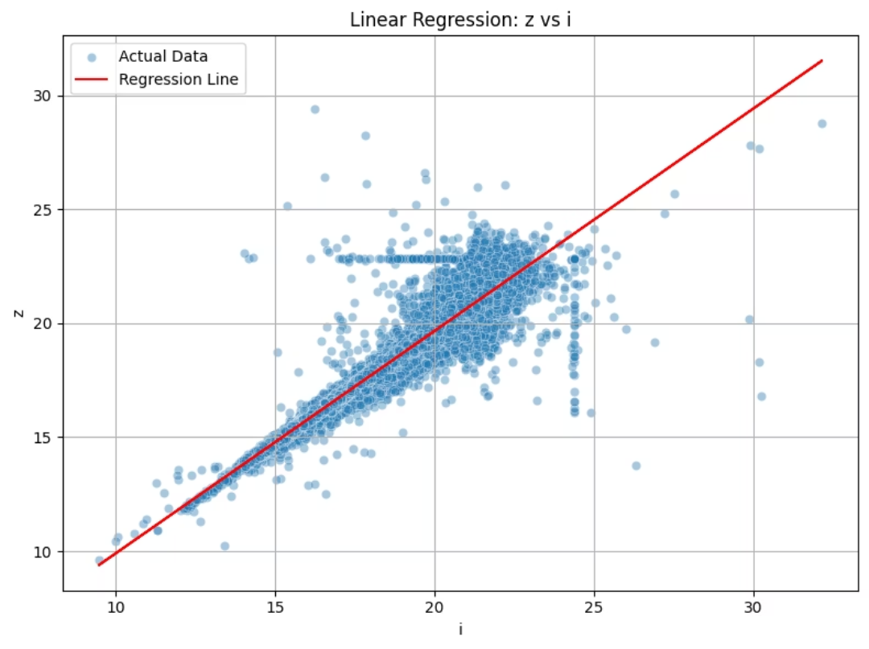
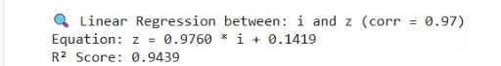
Figure 17: Linear Regression z vs i

Slide 37
Why We Use Color Indices (u–g, g–r, r–i, i–z) in Star Classification
What are Color Indices?
Color index = difference in magnitudes between two bands.
Example: g_r = g - r compares brightness in green (g) vs red (r).
Based on SDSS filters: u, g, r, i, z (from UV to infrared).
➤ Magnitude Reminder:
Lower magnitude = brighter object (log scale).
So g > r means object is dimmer in green, brighter in red → redder.
Why It Matters:
Color indices represent spectral shape.
Used for classifying objects (stars, galaxies, quasars).
Input to machine learning models for astronomical classification.

Slide 38
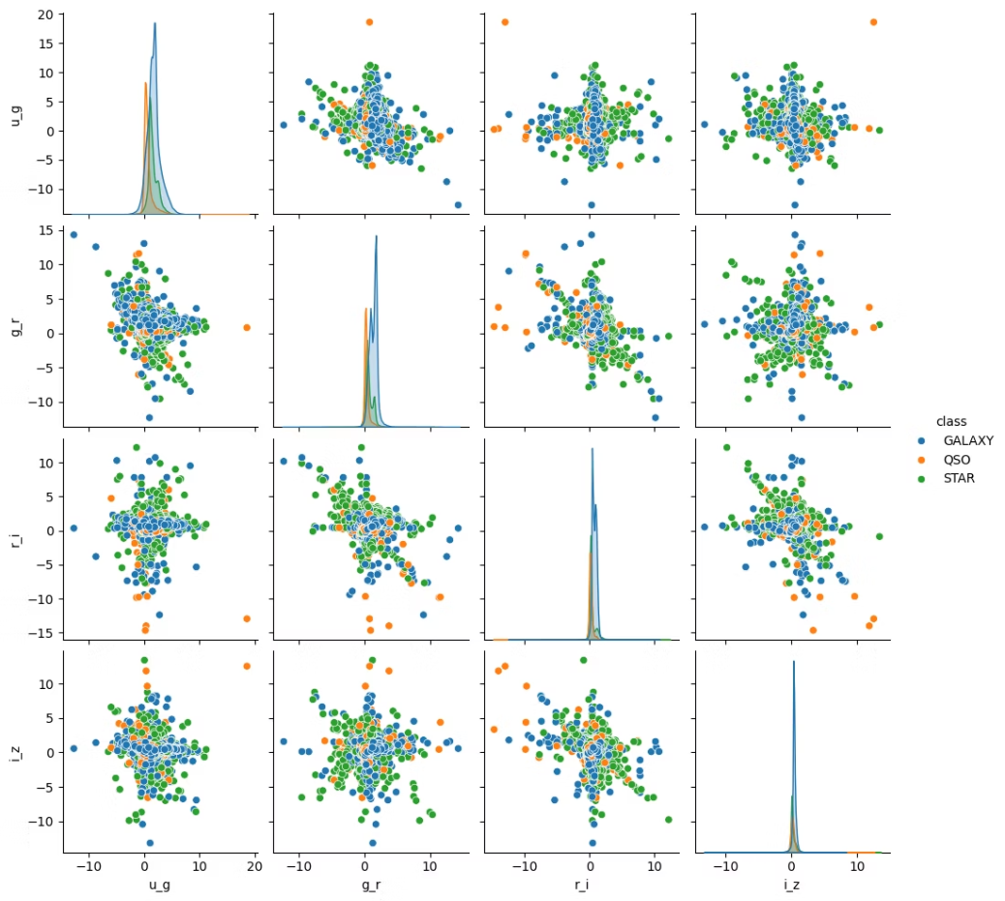
Figure 18: Pair plot of color indices (u–g, g–r, r–i, i–z) for different astronomical object classes. Each point represents an object, colored by class (e.g., star, galaxy, quasar). The plot highlights how color indices help distinguish object types based on their spectral characteristics.

Slide 39
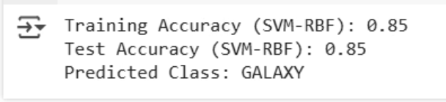
Support Vector Machine (SVM) Classification
We implement Support Vector Machine (SVM), a powerful supervised learning algorithm, for the task of classifying celestial objects into their respective class categories (GALAXY, STAR, QSO).
The process involves several key steps:
Feature and Target Selection: Color features (u_g, g_r, r_i, i_z) are selected as the independent variables (X), and the class column is designated as the target variable (y).
Data Splitting: The dataset is divided into training (70%) and testing (30%) sets. The model learns from the training data and is then evaluated on the unseen test data to assess its generalization capability.
Model Training: An SVC (Support Vector Classifier) model is trained using the training data. The kernel='rbf' indicates the use of a Radial Basis Function kernel, which allows the model to learn non-linear decision boundaries.
Prediction: The trained model makes predictions on both the training and test sets.
Accuracy Evaluation: The accuracy_score metric is calculated for both training and test predictions. This measures the proportion of correctly classified instances, indicating the model's performance.
Sample Prediction: A demonstration of how the trained model can predict the class of a single, unseen sample from the test set.
i) Example output

Slide 40
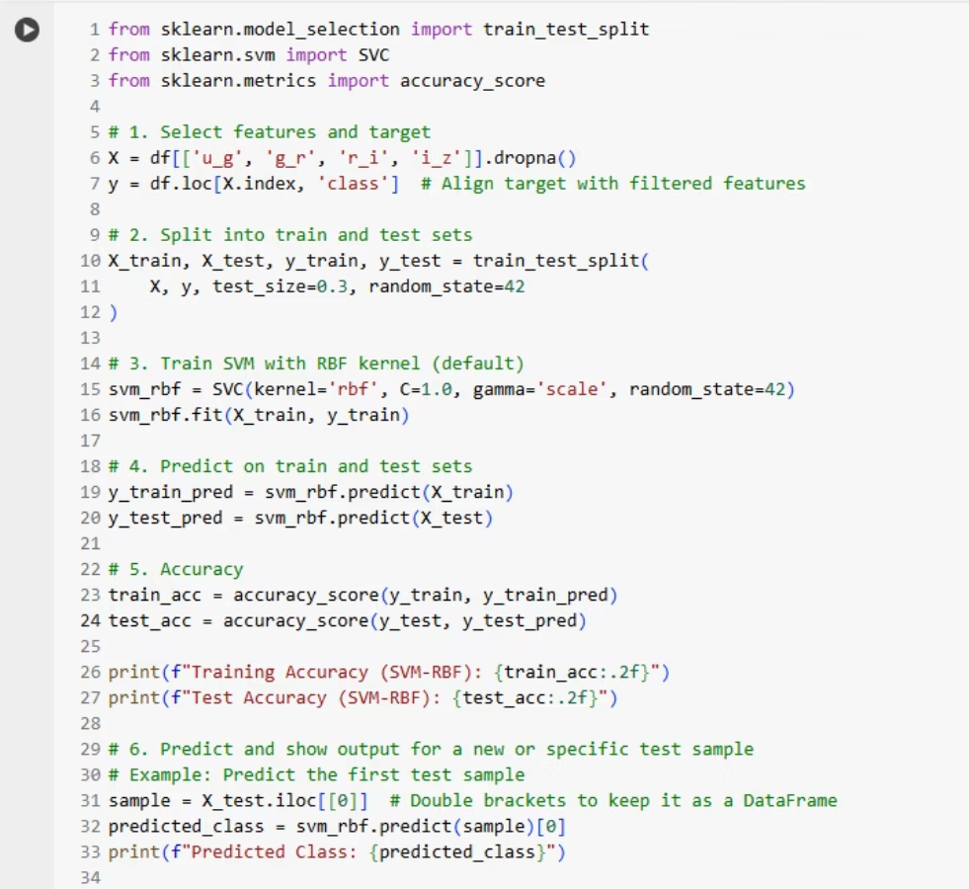
Code for SVM

Slide 41
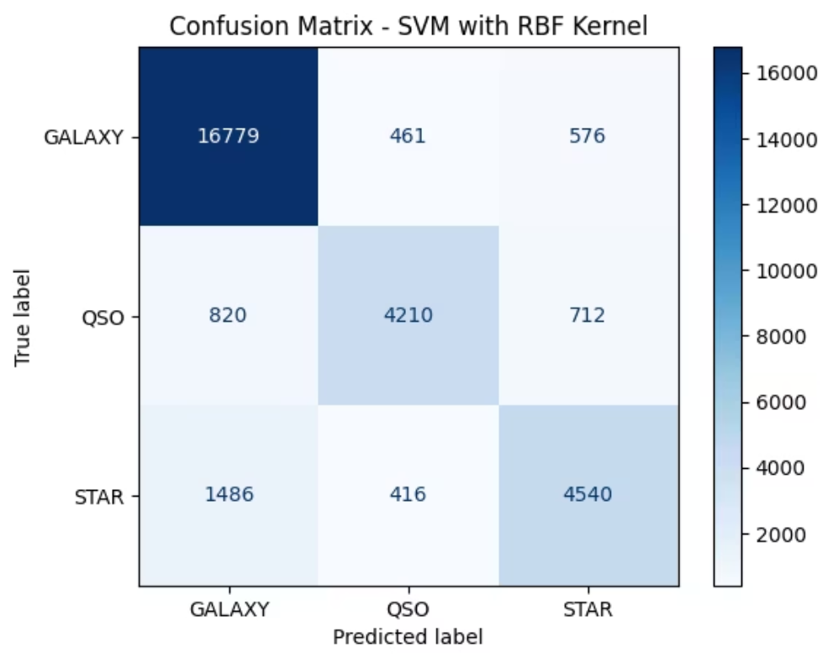
This is the confusion matrix for a Support Vector Machine (SVM) classifier using an RBF (Radial Basis Function) kernel. It evaluates how well the model classified three types of astronomical objects: GALAXY, QSO (quasi-stellar object), and STAR.
Figure 19: Confusion Matrix

Slide 42
Interpretation:
Diagonal values (top-left to bottom-right) are correct predictions:
16,779 galaxies correctly predicted as galaxies.
4,210 QSOs correctly predicted as QSOs.
4,540 stars correctly predicted as stars.
Off-diagonal values are misclassifications:
820 QSOs were misclassified as galaxies.
576 galaxies were misclassified as stars.
416 stars were misclassified as QSOs, etc.
Overall:
The model performs best on GALAXY classification (highest correct count).
It struggles more with QSO and STAR, especially confusing them with GALAXY

Slide 43
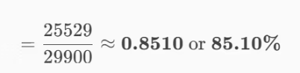
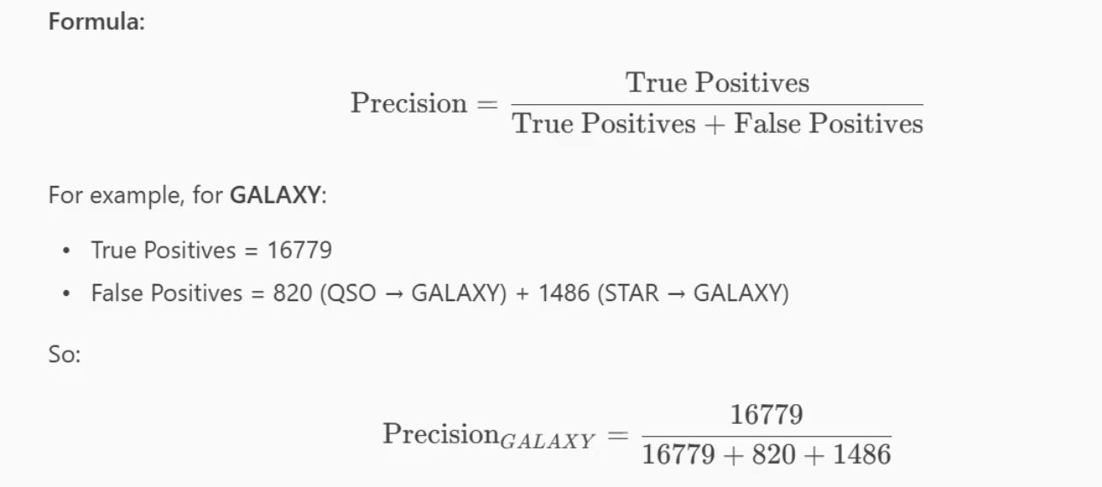
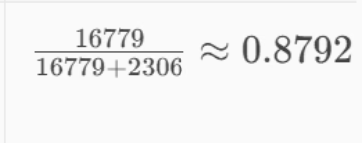
Accuracy
​Precision

Slide 44
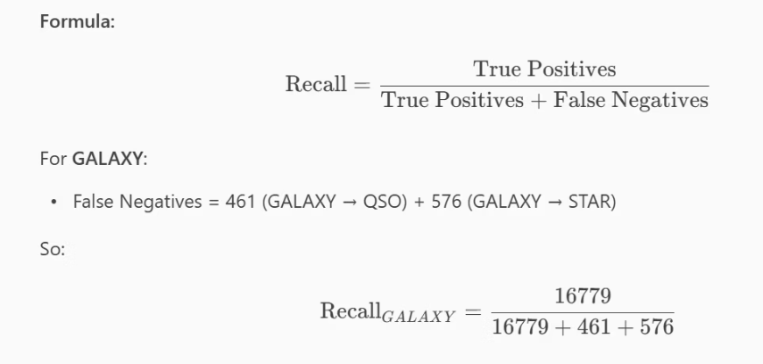
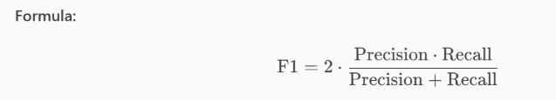
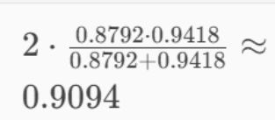
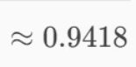
Recall F1-Score (per class)

Slide 45
Integrated K-Means Clustering
We applied K-Means clustering, an unsupervised learning algorithm, to the prepared color features (X).
It attempts to group the celestial objects into 3 clusters (assuming these correspond to the known 'Star', 'Galaxy', and 'QSO' classes) purely based on the similarity of their spectral characteristics, without using the class labels.
The subsequent scatter plot visualizes these discovered clusters in a 2D space (using u_g and g_r as axes), helping to understand if the data naturally forms distinct groupings. This can reveal inherent structures in the data or validate the natural separation of different object types.

Slide 46
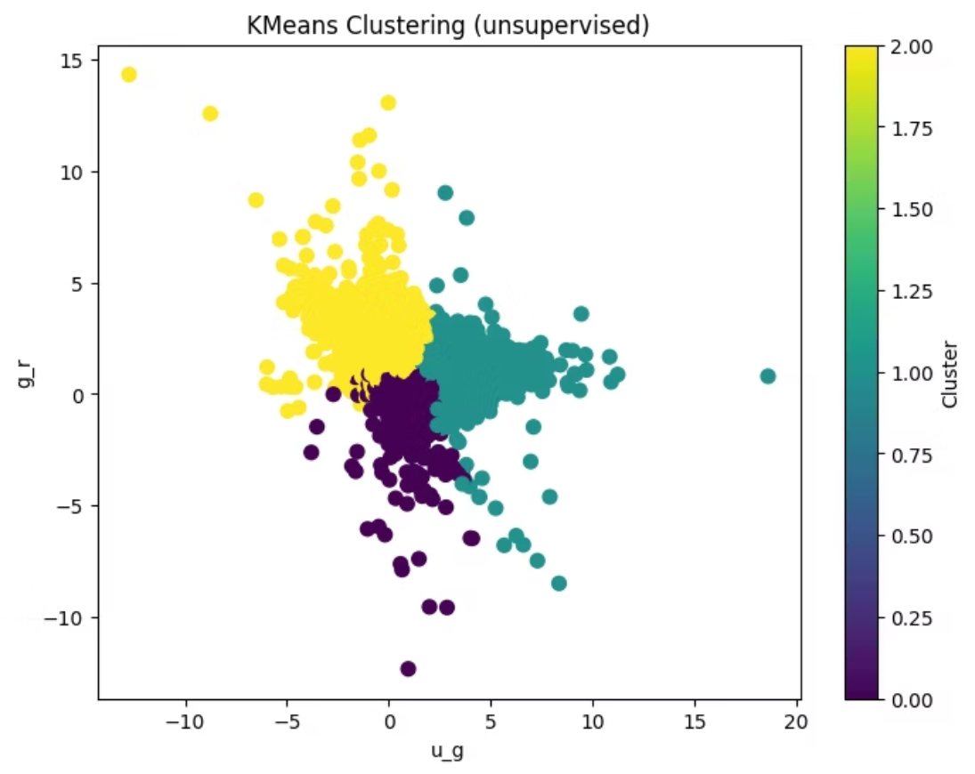
Figure 20: KMeans Clustering

Slide 47
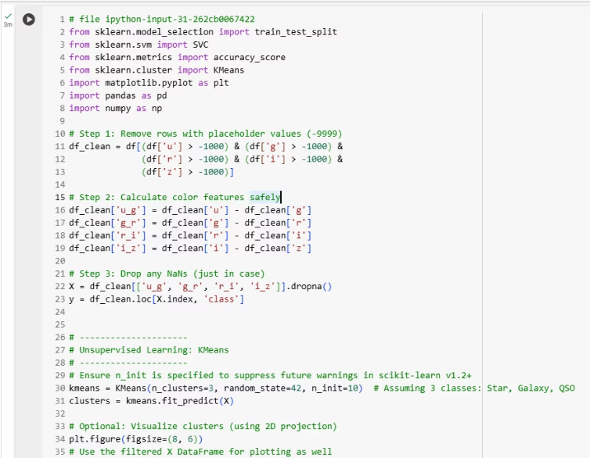

Code for KMeans Clustering

Slide 48

Results and Insights:
We learned through a systematic approach involving data preprocessing, extensive exploratory data analysis (EDA), and the application of both unsupervised and supervised machine learning techniques, we have gained significant insights into the star classification dataset.
Our analysis of the star classification project yielded the following precise insights:
Data Preparation: The star_classification.csv.xlsx dataset was loaded, cleaned of -9999.0 placeholders, and enhanced with discriminative 'color features' (u_g, g_r, etc.).
Exploratory Data Analysis (EDA): Visualizations (histograms, boxplots, pairplots, KDEs, correlation heatmaps) revealed key feature distributions, inter-feature relationships, and crucial insights into how well different celestial classes separate based on spectral properties.
K-Means Clustering: This unsupervised method effectively identified natural groupings within the data, supporting the inherent separability of celestial object types based on their spectral characteristics.
SVM Classification: The Supervised learning model demonstrated strong performance with 0.85 training and test accuracy, indicating robust prediction capability and excellent generalization for classifying celestial objects. The confusion matrix further detailed its class-specific performance.

Slide 49






Future Improvements:
Future Enhancements for Amateur Astronomers
Sharpening Our Celestial Sight: Refine the model to find even more subtle color 'fingerprints' of objects, enabling super-accurate classification of stars, galaxies, and quasars.
Physics-Informed Feature Engineering & Modeling:
Integrate domain-specific astrophysical knowledge directly into feature engineering (e.g., creating features based on theoretical stellar evolution tracks or redshift corrections).
Enhanced Data Handling: Improve model fairness by balancing out categories with fewer examples, ensuring all types of objects get a fair chance at accurate classification.

Slide 50

Conclusion
—
This project successfully developed and evaluated a machine learning pipeline for classifying celestial objects (Stars, Galaxies, and Quasars) based on their spectral characteristics.
Beginning with a robust data preprocessing phase, we effectively handled missing values and engineered insightful 'color features' crucial for distinction. Comprehensive Exploratory Data Analysis (EDA) provided deep understanding of the dataset's structure, feature distributions, and inter-class separability, visually confirming the discriminative power of spectral features.
Both unsupervised (K-Means clustering) and supervised (Support Vector Machine) learning approaches were applied. K-Means revealed inherent groupings within the data, supporting the natural differentiation of celestial object types. The SVM model demonstrated strong performance, achieving a test accuracy of 0.85. This robust accuracy, coupled with consistent training and test results, indicates the model's excellent generalization capabilities in classifying unseen astronomical observations.

